Slide 1
Funding & Maintaining Your School Garden

Slide 2
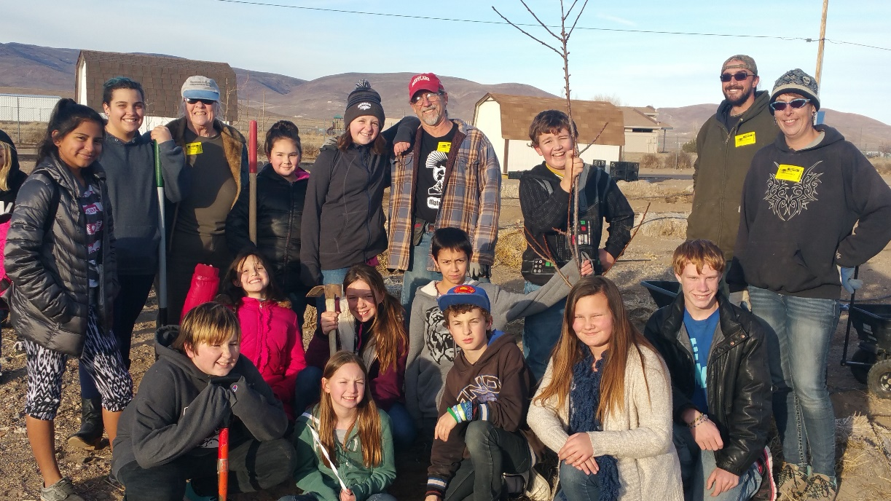
Before you begin…
Make a list:
WHO benefits from your garden?
Approx. # of kids
How often
WHAT learning is taking place?
Garden skills?
Math & science?
WHAT is the overall purpose?
Feed students?
Demonstrate the growing cycle?
Beneficial garden?

Slide 3
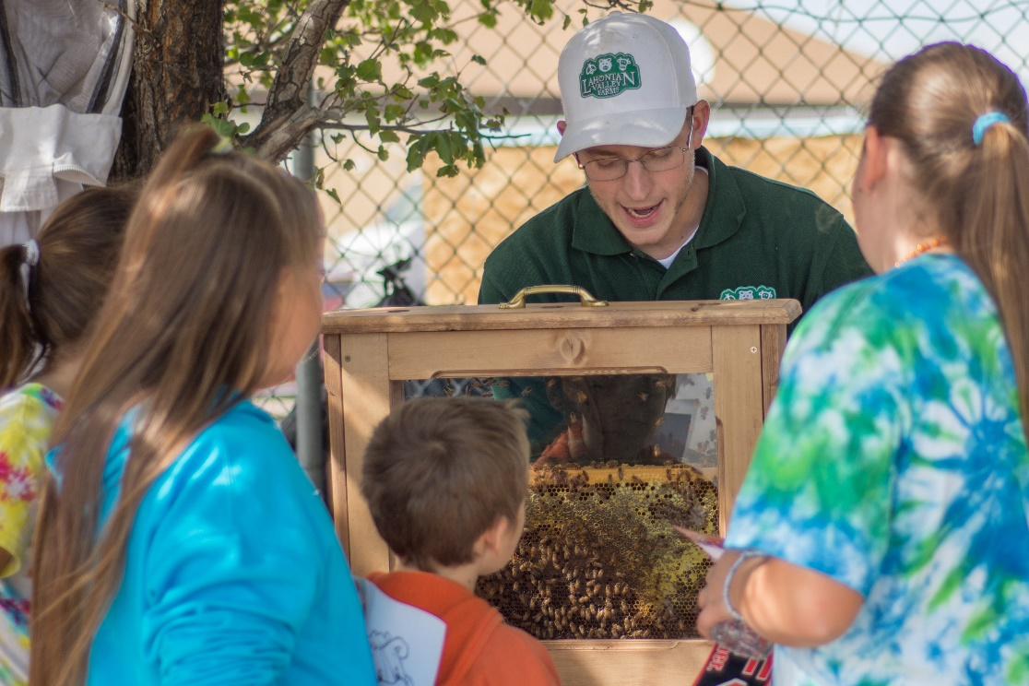
Funding
Start with what you have
Make CONNECTIONS
Then, ASK, ASK, ASK for supplies, help, and/or monetary donations
Parents
Students
Teachers & Staff
Community Members
YOUR family & friends
Groups such as Booster Clubs, PTA, etc.

Slide 4
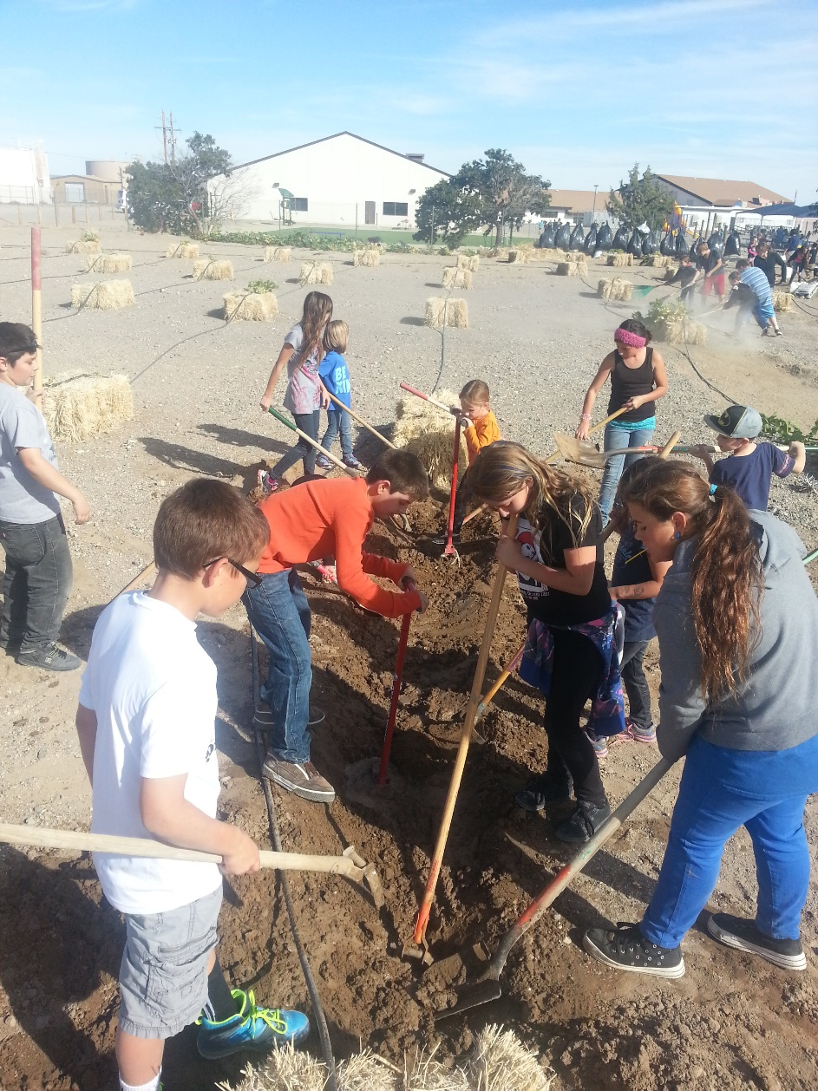
Funding
Once you run out of FREE options…
ASK, ASK, ASK for deals!
Discounts
Bulk purchases
Deal on ‘old’ or last season’s supplies (You will be SHOCKED by what people/businesses throw away)

Slide 5
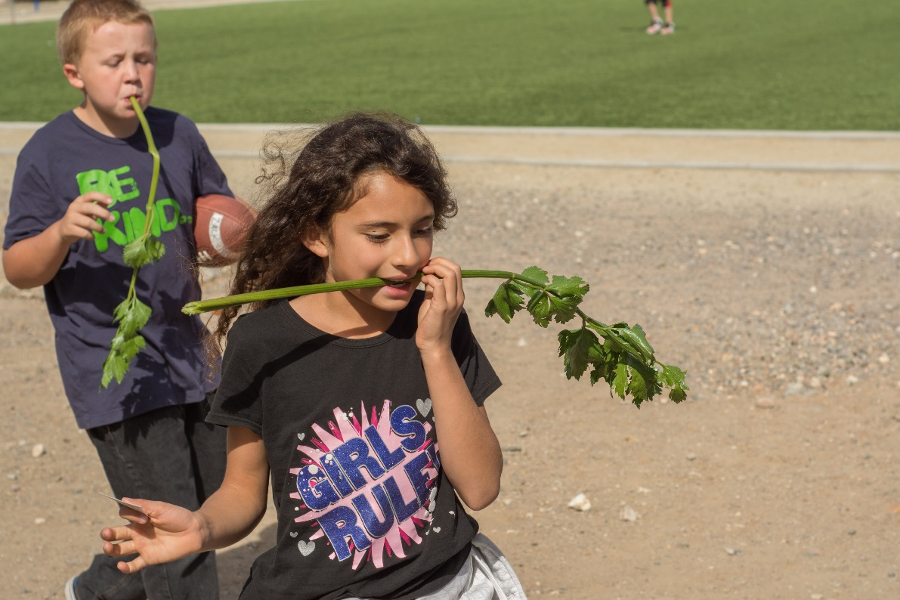
Funding
You’ve got stuff going on, but things would be better if you had some real money…
BEFORE you start looking into grants of any kind, check with your district grants department to see what their process is for applying for & accepting grant funding.

Slide 6
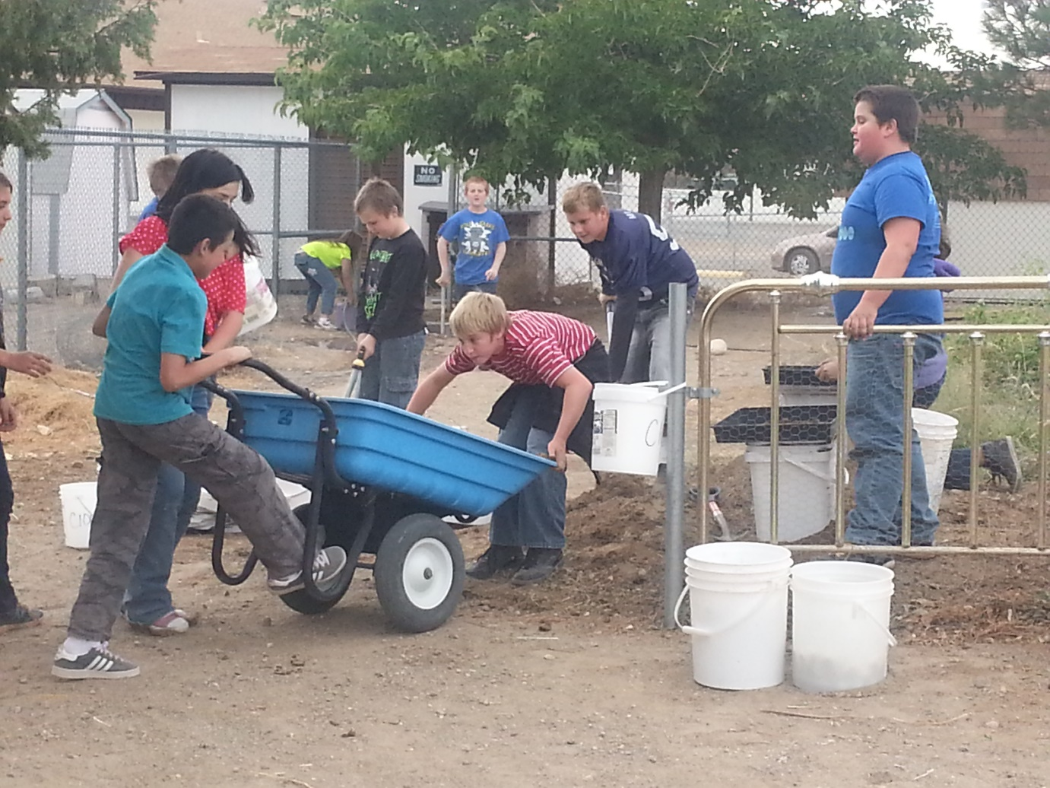
Funding - Grants
Grants
Data, data, data:
What are you doing?
Why is it unique?
Who benefits?
What makes you different?
Location (rural, inner city, etc.)
Food desert?
Low income? Title I?
How will you measure progress/success?

Slide 7
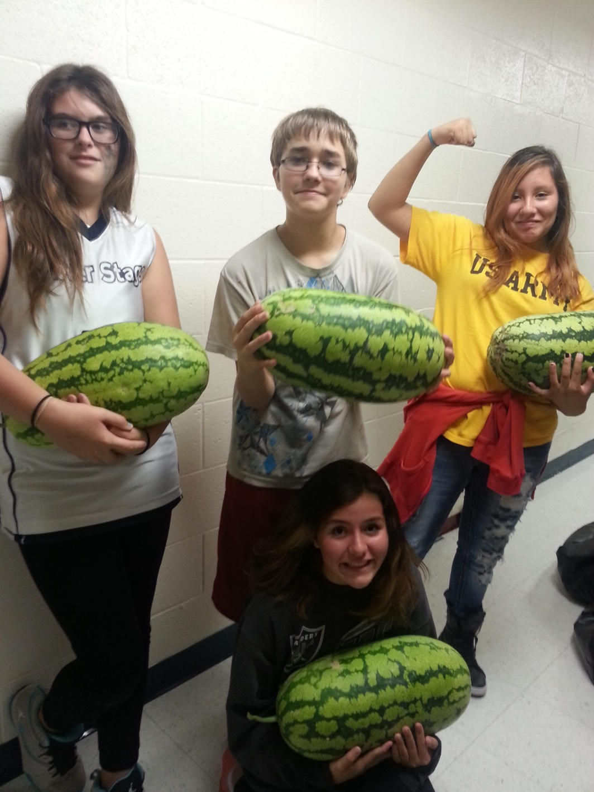
Funding - Fundraising
Gardens open up a new world of fundraising!
Farmer’s Market produce sale
Seeds/Seedling sale
Recycling
Craft fairs – plants, upcycling, etc.

Slide 8
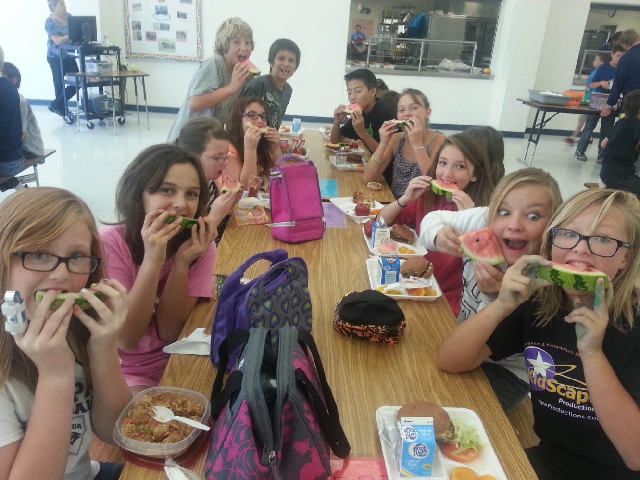
Garden Maintenance
Who is going to take care of everything?
Build a team
Parents & Students
Volunteers
Maintenance/custodial staff
Teachers & Staff

Slide 9
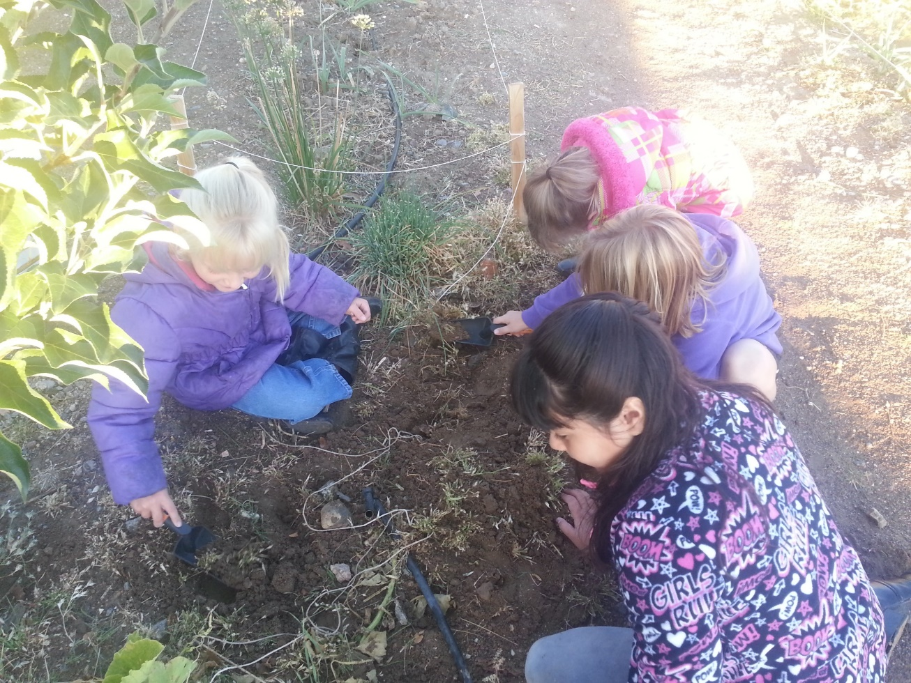
Garden Maintenance
Delegate, delegate, delegate!
Garden events
Invite people to your garden
Make a routine and stick with it!
Do NOT underestimate the value of a good drip system!

Slide 10
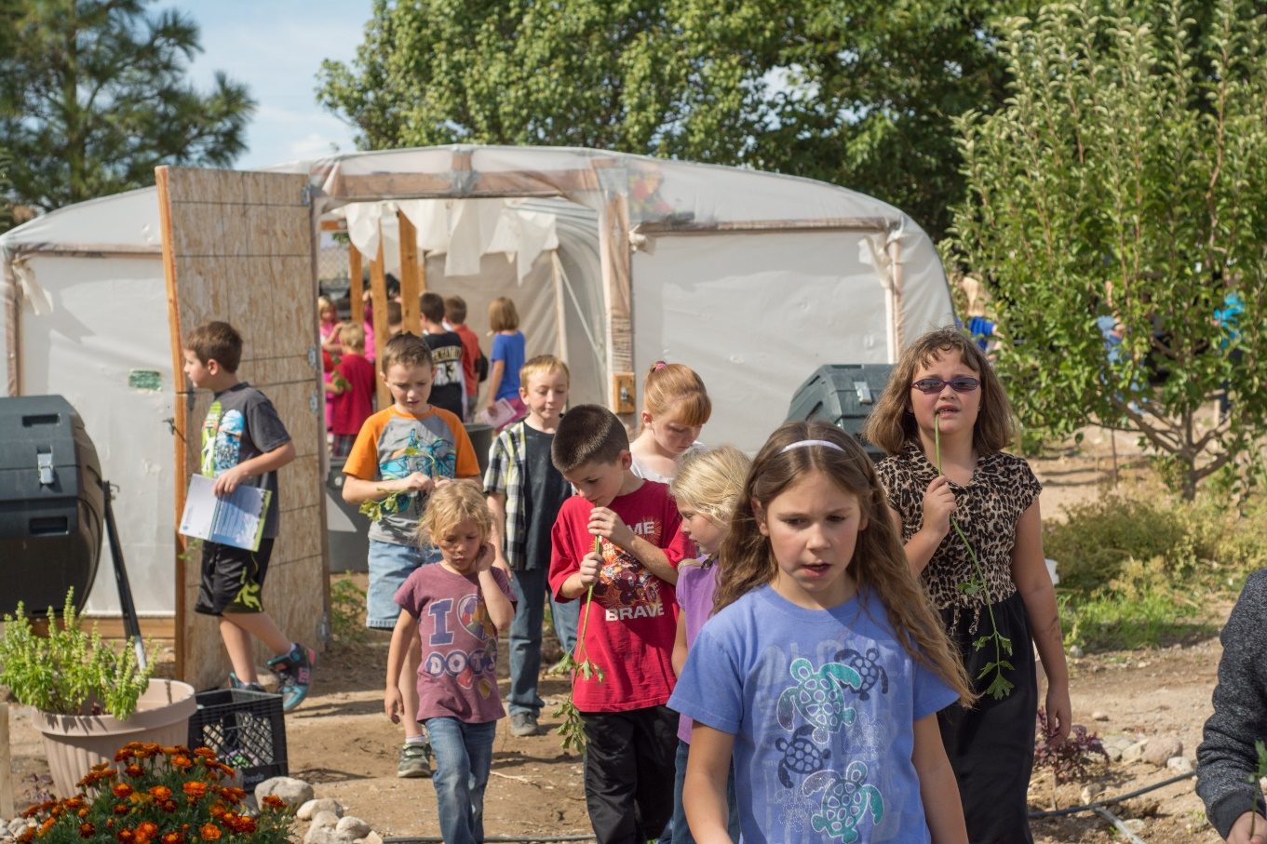
Finally…
School gardens are about KIDS.

Slide 11
Questions? Ideas? Wanna come visit???
Rachel Leach
Silver Stage Elementary School
G.R.E.E.N. Team
3800 Spruce Ave.
Silver Springs, NV 89429
(775) 577-5050 (school)
(775) 527-3842 (cell)
rleach@lyoncsd.org

